Slide 1


Supporting LGBTQ+ Youth
Ethan Czuy Levine, PhD (he/him/his)
LGBTQ+ Outreach Advocate, SERV
ethan.levine@centerffs.org

Slide 2
SERV Overview
Free and confidential victim-centered services to survivors of sexual violence, domestic violence, and human trafficking in Camden, Cumberland, & Gloucester counties Crisis intervention (24-hour hotline) and counseling
Medical, police, and court accompaniment
Safe housing for domestic violence survivors in Gloucester & Cumberland
Public education and prevention

Slide 3
LGBTQ+ Work at SERV
New Program in 2018, Funded through August 2019
  Ethan Levine, LGBTQ+ Outreach Advocate
  Kristina Sullivan, LGBTQ+ Outreach Counselor
Program Goals
  Developing tailored support and direct services at SERV
  Outreach with LGBTQ+ communities in South Jersey
  Outreach with professionals who serve those communities
  Providing training and technical assistance to build inclusive, affirming environments for LGBTQ+ survivors and their significant others

Slide 4
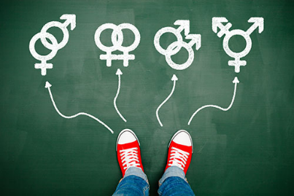
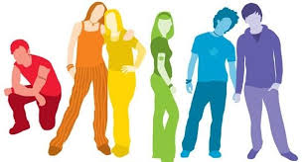
Agenda
LGBTQ+ 101
  What does it all mean?
  Sexuality and Gender Basics
Issues facing LGBTQ+ youth
  Violence, mental health, substance use
  Homelessness, juvenile justice
Barriers to care
Supporting LGBTQ+ youth

Slide 5
LGBTQ+ 101
Terminology
The basics of sexuality & gender

Slide 6
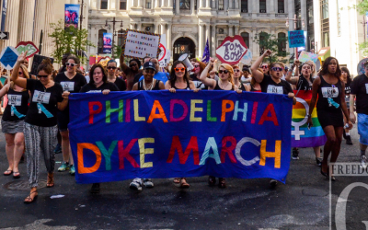

LGBTQ+… What does it all mean?
“Sexual and Gender Minority” Communities
L = Lesbian
Women who are primarily attracted to other women, whether emotionally and/or sexually
Some women who fit this definition use different language, such as:
  Same gender loving
  Women who have sex with women (WSW)

Slide 7
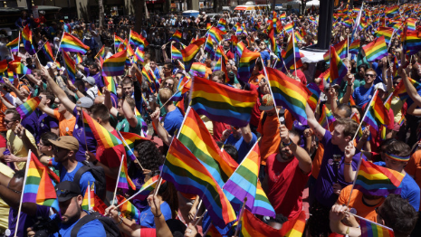
LGBTQ+… What does it all mean?
“Sexual and Gender Minority” Communities
G = Gay
Men who are primarily attracted to other men, whether emotionally and/or sexually
Some men who fit this definition use different language, such as:
  Same gender loving
  Men who have sex with men (MSM)

Slide 8
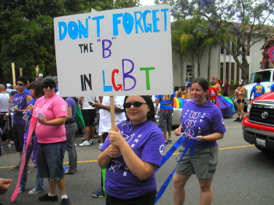

LGBTQ+… What does it all mean?
“Sexual and Gender Minority” Communities
B = Bisexual
Individuals who are attracted to both men and women, or to people of all genders
Some people who fit this definition use different language, such as:
  Pansexual
  Queer

Slide 9
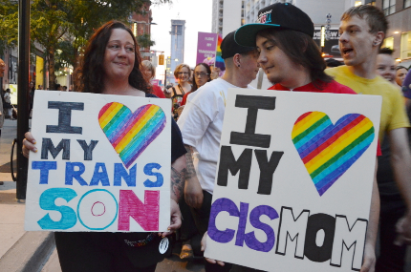

LGBTQ+… What does it all mean?
“Sexual and Gender Minority” Communities
T = Transgender
Individuals whose gender identity differs from their assigned sex at birth
May take various steps to transition, or to align gender expression with gender identity
Note: gender identity and sexuality are not the same thing!

Slide 10
Transgender Identities
Some trans individuals identify as men or women
  Transgender men are men who were assigned female at birth. You may also hear the terms female-to-male, FTM, or man of trans experience.
  Transgender women are women who were assigned male at birth. You may also hear the terms male-to-female, MTF, or woman of trans experience.
Some trans individuals identify as nonbinary
  May identify as genderqueer, genderfluid, or decline to label their gender altogether

Slide 11
LGBTQ+… What does it all mean?
“Sexual and Gender Minority” Communities
Q = Queer
  Umbrella term for sexual minorities, or people who are not heterosexual
  Sexual identity label
  Rejection of sexual identity labels
Q = Questioning
  Individuals who are exploring or questioning their sexualities

Slide 12
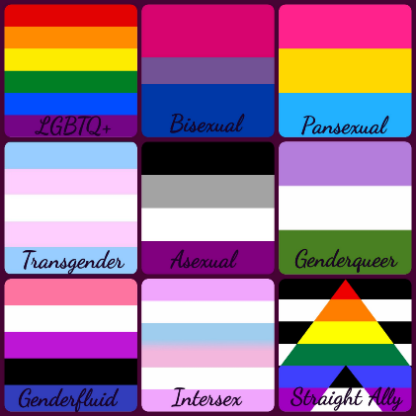
LGBTQ+… What does it all mean?
“Sexual and Gender Minority” Communities
+ = Other Sexual and Gender Minorities
Includes a wide range of sexualities, including but not limited to:
  Asexual individuals, who experience minimal or no sexual desire/attraction
  People in consensually nonmonagamous relationships (e.g., open relationships, polyamory)
  Individuals in BDSM communities

Slide 13
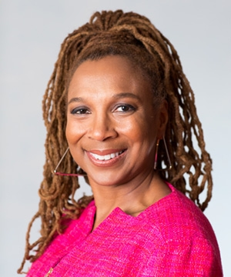
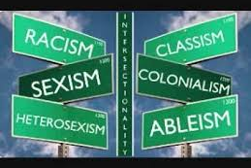
Intersectionality
Diversity within LGBTQ+ communities
  Identity, experience, values
  Violence and oppression
  Barriers to support
  Resilience
Violence is not evenly distributed
Resources are not evenly distributed
LGBTQ+ people experience “the same” issues in different ways

Slide 14

Who else is there?
Heterosexual or straight: most privileged sexual orientation. Refers to women who are primarily emotionally/sexually attracted to men, and men who are primarily emotionally/sexually attracted to women.
Cisgender or nontransgender: refers to people whose identities match their assigned sex/gender.

Slide 15
Sexuality
Orientation (desire)
Behavior (action)
Identity (label)
Notes:
Lead: Ethan

Slide 16
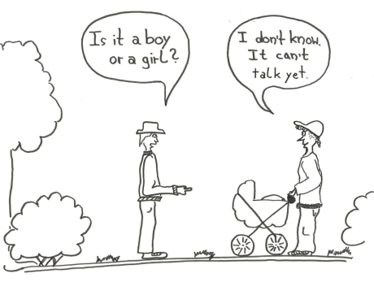
Sex and Gender
Sex
  Based on biological/physical characteristics
  Assigned at birth
Gender
  Social categories
  Assigned at birth, presumed to “line up” with assigned sex
Gender identity
  Personal sense of self
  Presumed to “line up” with sex/gender
Gender expression
  How individuals express/present their gender identity
  Expressions of masculinity, femininity, androgyny

Slide 17
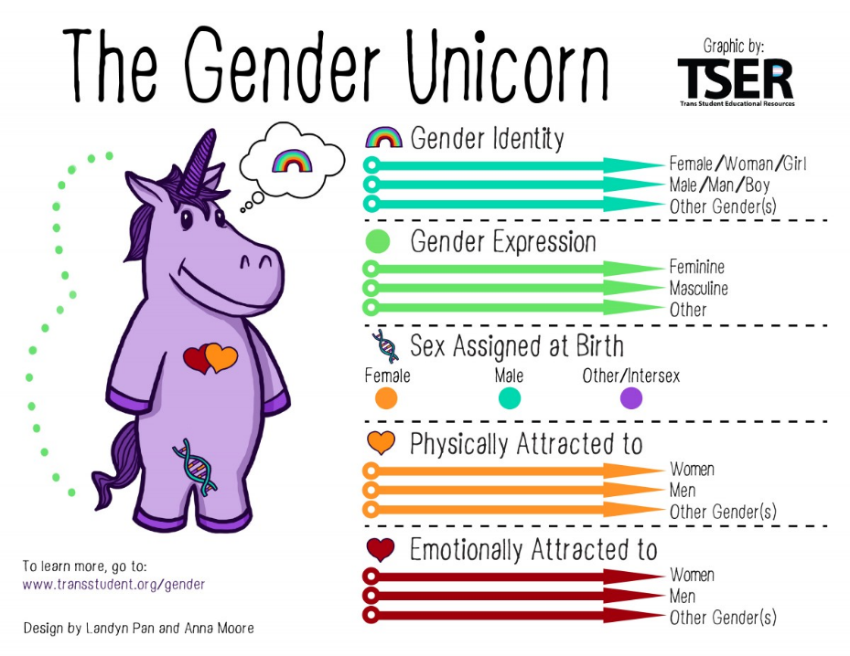

Slide 18
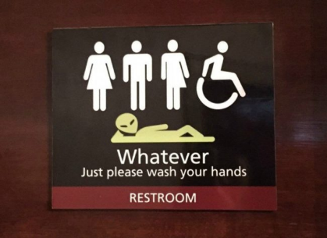
Sexuality & Gender in Daily Life
Everyday conversation
IDs and Documentation
Gendered spaces
  Bathrooms, locker rooms
  Single-sex schools, prisons, sports teams
  Activist communities, women-only spaces
Gender roles in different contexts
  Religious communities, family, work, school

Slide 19
Issues Facing LGBTQ+ Youth
Bullying and interpersonal violence
Childhood sexual abuse
Mental health and substance use
Homelessness
Juvenile Justice

Slide 20
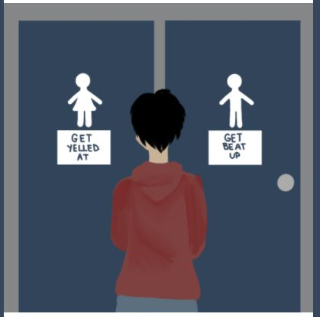
Interpersonal Violence and Bullying in LGBTQ+ Youth Communities
GLSEN, 2015 National School Climate Survey¹
  71% of LGBTQ students report verbal harassment and 27% report physical harassment around sexual orientation
  55% report verbal harassment and 8% report physical harassment around gender expression
  60% report sexual harassment in school
  58% felt unsafe at school due to their sexual orientation, and 43% felt unsafe because of their gender expression

Slide 21
Interpersonal Violence and Bullying in LGBTQ+ Youth Communities
NCTE, 2015 U.S. Transgender Survey²
  Of those who were out or perceived as trans in K-12, 54% were verbally harassed, 24% were physically attacked, and 13% were sexually assaulted because of being transgender
  17% left a K-12 school due to anti-trans mistreatment
  24% of those who were out or perceived as trans in college or vocational school experienced verbal, physical, and/or sexual harassment

Slide 22
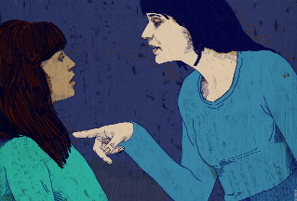
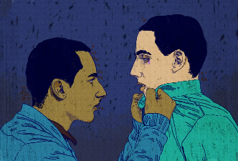
Interpersonal Violence and Bullying in LGBTQ+ Youth Communities
CDC, 2015 Youth Risk Behavior Survey³
Relative to their heterosexual peers, sexual minority youth report higher rates of:
    Being physically forced to have sex (18% vs. 5%)
    Sexual dating violence (23% vs. 9%)
    Physical dating violence (18% vs. 8%)

Slide 23
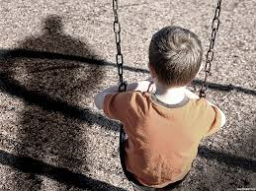
Childhood Sexual Abuse in LGBTQ+ Youth Communities
Sexual Minority Youth⁴
  Overall, about 3x more likely to report CSA
  40% bisexual, 32% lesbian, 17% heterosexual females
  25% bisexual, 21% gay, 5% heterosexual males
Transgender youth⁵
  Limited data, but consistently high rates
  55% of participants in one clinical study
Stigma and isolation contribute to violence

Slide 24

Childhood Sexual Abuse in LGBTQ+ Youth Communities
I was apprehensive about writing about being molested because I feared others would…[point] to the abuse as the cause of my being trans – as if my identity as a woman is linked to some perversion, wrongdoing, or deviance. What must be made clear is that my gender expression and identity as a girl predated [the abuse], and my expression as a child made me vulnerable and isolated, an easier target for [abuser].
Janet Mock, Redefining Realness⁶ (p49-50)

Slide 25
Mental Health and Substance Use in LGBTQ+ Youth Communities
CDC, 2015 Youth Risk Behavior Survey³
Relative to their heterosexual peers, sexual minority youth report higher rates of:
    Feeling so sad or hopeless every day that they stopped usual activities (60% vs. 26%)
    Attempting suicide (29% vs. 6%)
    Daily cigarette smoking (4% vs. 2%)
    Current alcohol use (41% vs. 32%)
    Current marijuana use (32% vs. 21%)
    Any use of hallucinogenic drugs, cocaine, ecstasy, heron, methamphetamines, non-prescribed steroids, inhalants, injection drug use

Slide 26
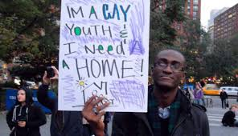
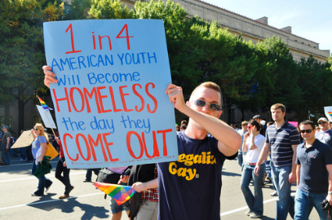
Homelessness
Williams Institute, Serving Our Youth (2012)⁷
  Agencies report that approximately 40% of homeless youth clientele are LGBTQ+
  Family rejection is the top cause of LGBTQ+ youth homelessness
  Keuroghlian et al., “Out on the Street” (2014)⁸
  Relative to heterosexual homeless youth, homeless LGBTQ+ youth experience elevated mental health risks, substance use, sexual victimization, and engagement in survival sex

Slide 27
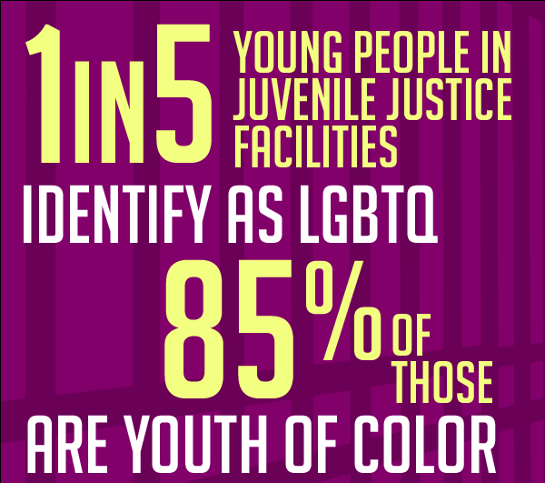
Juvenile Justice
Juvenile Detention Alternatives Initiative, LGBT Youth in the Juvenile Justice System (2015)⁹
  Queer, trans, and gender nonconforming youth are overrepresented in juvenile justice
  Overrepresentation is particularly pronounced for girls and youth of color
  LGBT youth face higher risks of profiling, arrest for minor and victimless offenses, and extended detention/supervision than heterosexual and cisgender youth
  LGBT youth report disproportionately high rates of sexual abuse during detention

Slide 28
Barriers to Care
Sexuality, gender, and support services
Issues in health care, social services, and other fields

Slide 29
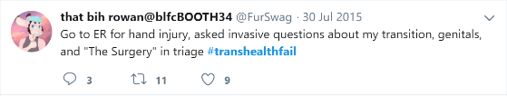

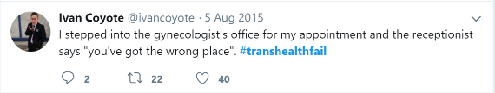
Sexuality, Gender, & Support Services
Check-in
  ID and paperwork
  Interactions with staff
  Waiting room environments
Gender/Sexuality-specific services
  Sexual health and reproductive care
  Emergency shelter and safe housing
  Recovery programs and support groups
Cultural and historical barriers to services
  Provider knowledge and comfort
  Legal and illegal discrimination

Slide 30
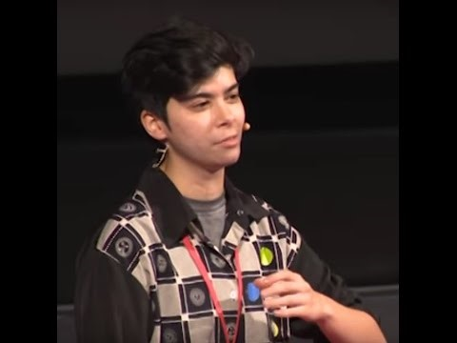
Provider Knowledge, Comfort, and Discrimination in Services

Slide 31
Local Barriers to Support
Insights from SNJ Providers
Agency capacity to support LGBTQ+ youth
Inclusive resources
Parents and other family members
Agency policies
Presence of and support for LGBTQ+ staff

Slide 32
Supporting LGBTQ+ Youth
What can we do with all of this information?

Slide 33

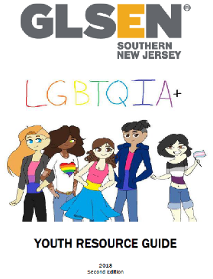

What can we do?
Insights from SNJ Providers
Staff training
Actively maintained resource guides
Expand existing programs to include LGBTQ+ communities
Support/create LGBTQ+ specific services, such as drop-in centers, residential facilities, support groups
Assess/adjust forms & policies
Partner with LGBTQ+ agencies

Slide 34
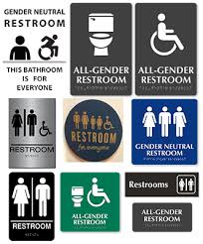
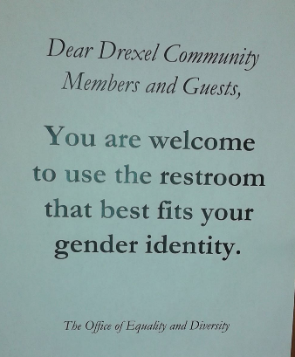
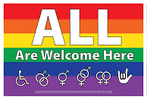
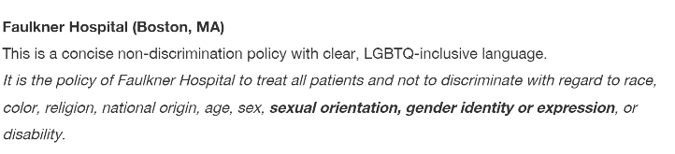
Show Your Commitment to Inclusion

Slide 35
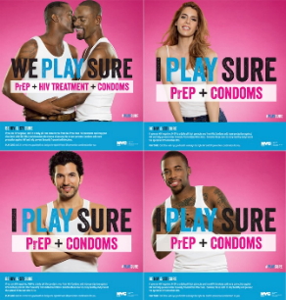
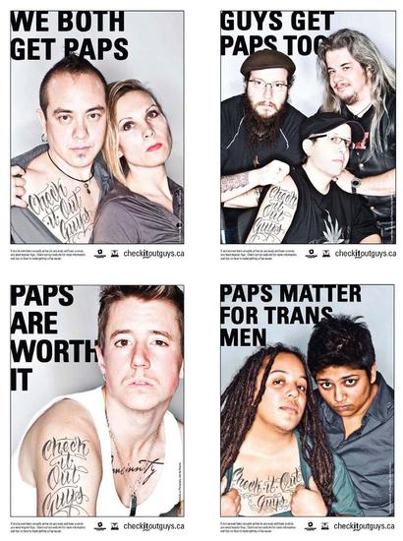
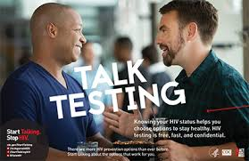
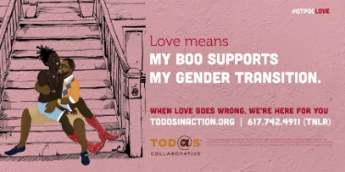
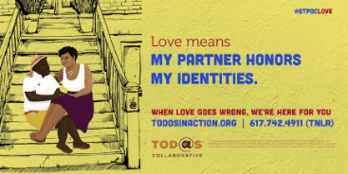
Show Your Commitment to Inclusion

Slide 36
What can we do?
Be an active ally!
Check our assumptions
  Pronouns and gender identity
  Sexuality, including relationships and identity labels
  What do I need to know/understand to support this person? To provide care?
Build trust
  You do this already!
  Be open to corrections
Recognize unique needs and concerns of LGBTQ+ youth

Slide 37
What can we do?
Practice inclusive and affirming language
  Asking for pronouns, sharing yours, and using gender inclusive language
  Know and tell why
Assess agency forms and policies, if possible
  Space for people to describe their identities and concerns in detail
  Waiting rooms and other environments
  Navigating conflict in group services, such as shelter and support groups
  Provide options for shifting between gender-specific services
Reach out and collaborate!

Slide 38
References
¹Kossciw, J. G., et al. 2016. The 2015 National School Climate Survey: The Experiences of Lesbian, Gay, Bisexual, Transgender, and Queer Youth in Our Nation’s Schools. New York: GLSEN.
²James, S. E., et al. 2016. The Report of the 2015 U.S. Transgender Survey. Washington, DC: National Center for Transgender Equality.
³Kann, L., et al. 2016. “Sexual Identity, Sex of Sexual Contacts, and Health-Related Behaviors Among Students in Grades 9-12 – United States and Selected Sites, 2015.” MMWR Surveillance Summaries, SS-9: 1-202.
⁴Friedman, M. S., et al. 2011. “A Meta-Analysis of Disparities in Childhood Sexual Abuse, Parent Physical Abuse, and Peer Victimization Among Sexual Minority and Sexual Nonminority Individuals. American Journal of Public Health 101(8): 1481-1494.

Slide 39
References
⁵Gehring, D. & Knudson, G. 2005. “Prevalence of Childhood Trauma in a Clinical Population of Transsexual People.” International Journal of Transgenderism 8(1): 23-30.
⁶Mock, J. 2014. Redefining Realness: My Path to Womanhood, Identity, Love, and So Much More. New York: Atria.
⁷Durso, L. E. & Gates, G. J. 2012. Serving Our Youth: Findings from a National Survey of Service Providers Working with Lesbian, Gay, Bisexual, and Transgender Youth who are Homeless or At Risk of Becoming Homeless. Los Angeles: The Williams Institute with True Colors and The Palette Fund.
⁸Keuroghlian, A. S., et al. 2014. “Out on the Street: A Public Health and Policy Agenda for Lesbian, Gay, Bisexual, and Transgender Youth Who Are Homeless.” American Journal of Orthopsychiatry 84(1): 66-72.
⁹Wilber, S. 2015. Lesbian, Gay, Bisexual, and Transgender Youth in the Juvenile Justice System. Baltimore, MD: Juvenile Detention Alternatives Initiative, Annie E. Casey Foundation.

Slide 40

Thank you!
Any questions?
Ethan Levine, PhD (he/him/his)
LGBTQ+ Outreach Advocate
ethan.levine@centerffs.org, (856) 881 – 4034, ext 42126

